Slide 1

Data Analysis & Visualization
DB group
Randunu Pathirannehelage Akila Madhushanka Pathirana
Hewa Walimunige Wasantha
Gimhani Kaushalya Garusing Arachchige

Slide 2

Project Work
The project work involves three main components:
Data processing
The Application of Statistical Methods
Visualization

Slide 3

Data set for the project work:
Data source- https://www.kaggle.com/datasets/debajyotipodder/co2-emission-by-vehicles
This dataset captures the details of how CO2 emissions by a vehicle can vary with the different features.
The dataset has been taken from Canada Government official open data website.
This contains data over a period of 7 years.

Slide 4
Background
This dataset captures the details of how CO2 emissions by a vehicle can vary with the different features.
City and highway fuel consumption ratings are shown in liters per 100 kilometers (L/100 km)
The combined rating (55% city, 45% hwy) is shown in L/100 km and in miles per gallon (mpg)
There are few abbreviations that has been used to describe the features.
Model
4WD/4X4 = Four-wheel drive
AWD = All-wheel drive
FFV = Flexible-fuel vehicle
SWB = Short wheelbase
LWB = Long wheelbase
EWB = Extended wheelbase
Transmission
A = Automatic
AM = Automated manual
AS = Automatic with select shift
AV = Continuously variable
M = Manual
3 - 10 = Number of gears
Fuel type
X = Regular gasoline
Z = Premium gasoline
D = Diesel
E = Ethanol (E85)
N = Natural gas

Slide 5
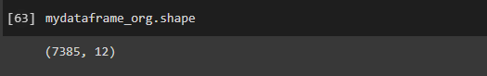
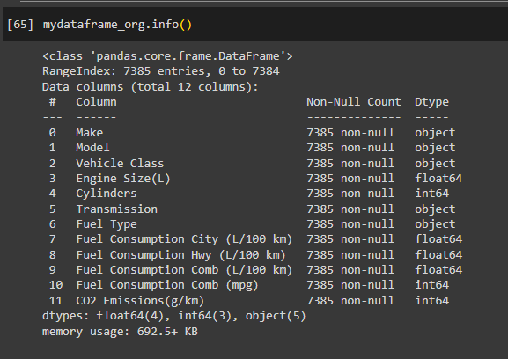
1. Data Processing
1.1 Number of
rows: 7385
cols: 12
1.2 Data Types
Integer (3 cols),
float (4 cols),
String (5 cols)

Slide 6
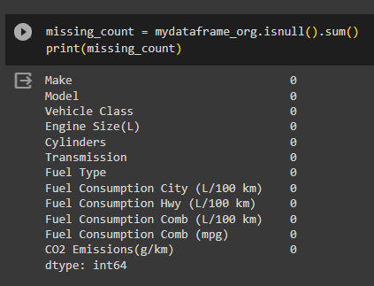
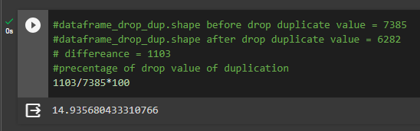
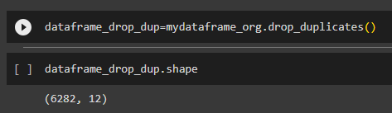
1.3 Missing values – No (0%)
1.4 Duplicates
duplicates rows: 1103 (15%)
duplicates cols : 0 (0%)
1.5 Removing duplicates
unique rows: 6282
unique cols : 12

Slide 7
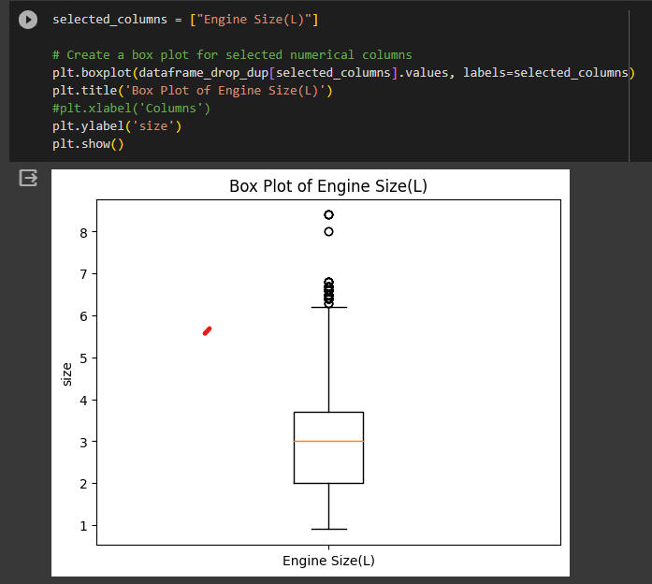
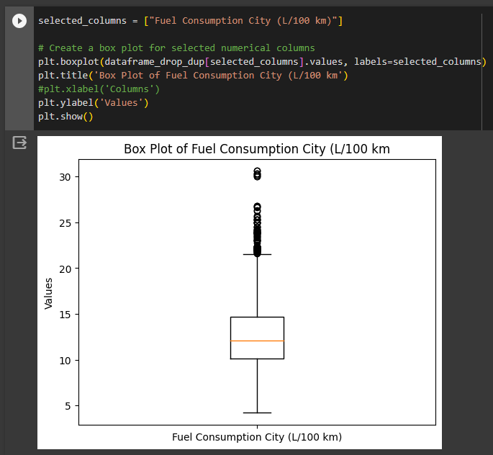
1.6 Outliers
Engine size outliers-
It can be noticed that there are 2 outlier values for engine size. They are 8 and 8.4.
Fuel Consumption City outliers-
It can be noticed that there are several outlier values above 27 for Fuel Consumption in cities.

Slide 8
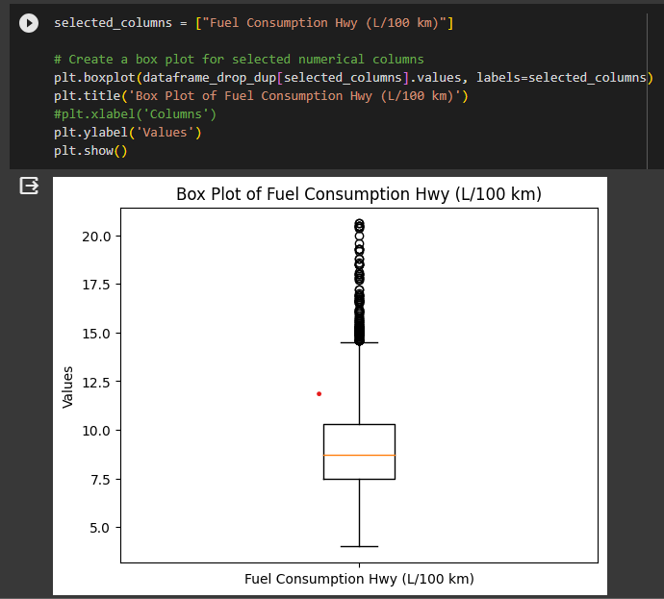
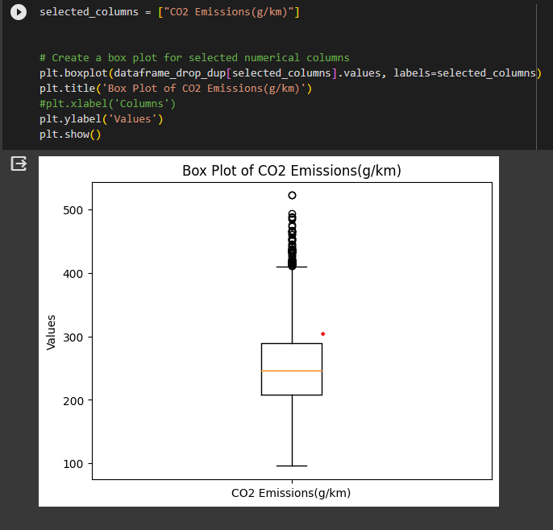
Fuel Consumption Highway outliers-
It can be evaluated that there are no significant outliers for Fuel consumption in highways
CO2 Emissions outliers-
It can be noticed that there is one outlier value for CO2 Emissions which is above 500.

Slide 9
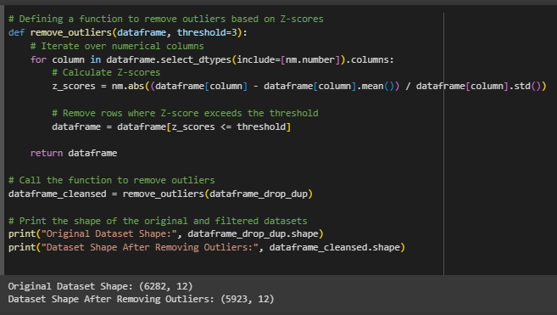
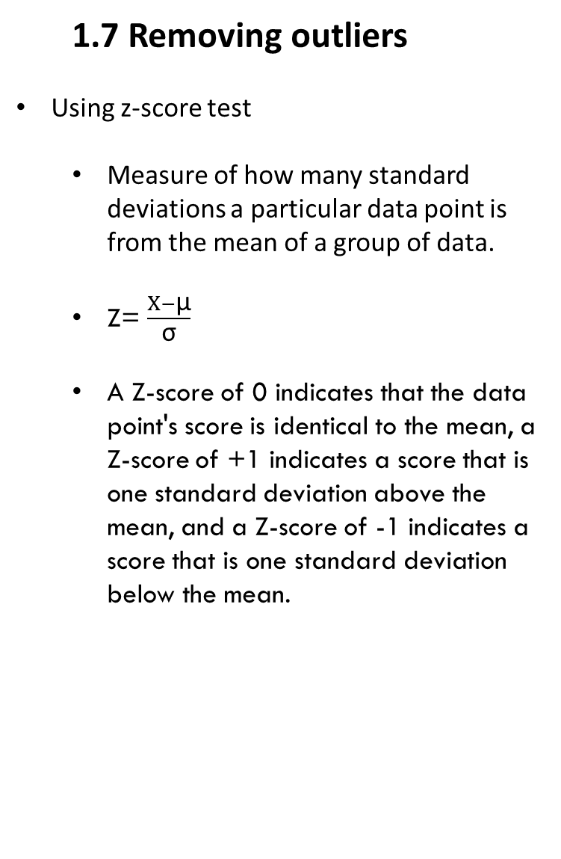
1.7 Removing outliers
Using z-score test
Measure of how many standard deviations a particular data point is from the mean of a group of data.
Z= $\frac{X−\text{μ}}{\text{σ}}$
A Z-score of 0 indicates that the data point's score is identical to the mean, a Z-score of +1 indicates a score that is one standard deviation above the mean, and a Z-score of -1 indicates a score that is one standard deviation below the mean.
​
# of unique rows after removing outliers
5293

Slide 10
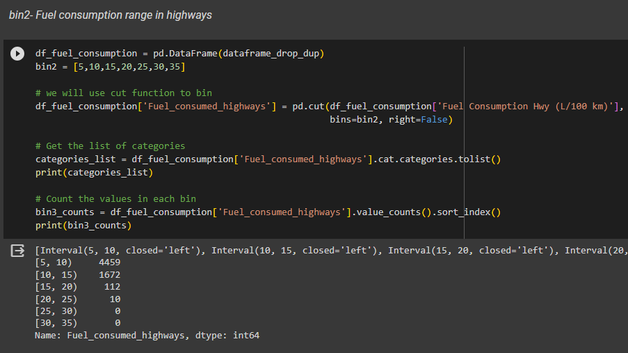
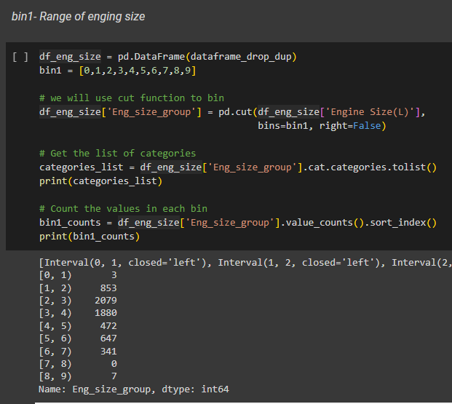
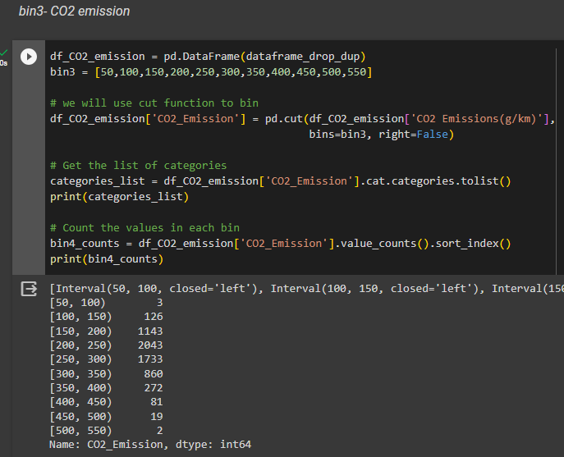
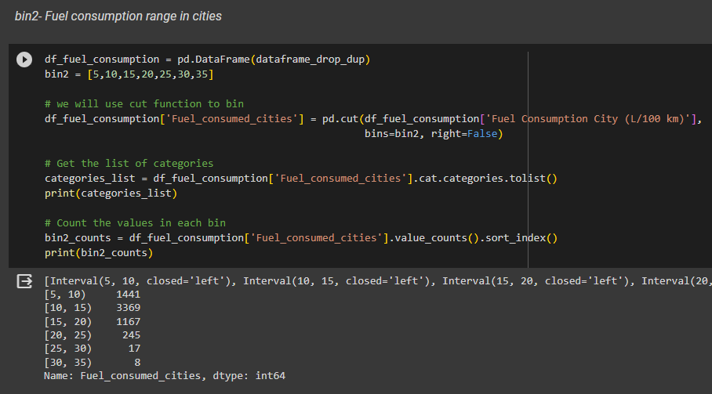
1.8 Bins
bin1-
bin3-
bin2-

Slide 11
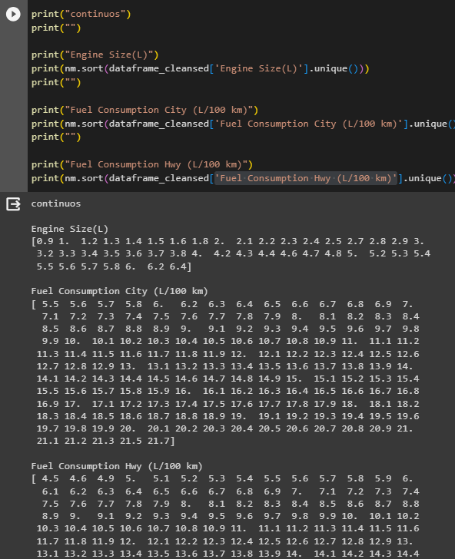
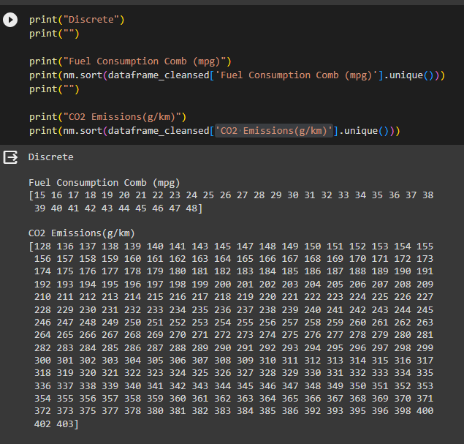
2. Data Objects & Attribute Types
Data objects | Column names
Nominal data | 'make', 'Model', 'Vehicleclass', 'Transmission'
Binary data | null
Ordinal data | 'Cylinders'
Numeric type | Column names
Discrete | 'Fuel Consumption Comb (mpg)' 'CO2 Emissions(g/km)'
Continuous | 'Engine Size(L)' 'Fuel Consumption City (L/100 km)' 'Fuel Consumption Hwy (L/100 km)'
Notes:
Examples of nominal attributes include:
Gender: Categories might include "Male" and "Female."
Colors: Categories might include "Red," "Blue," and "Green."
Marital Status: Categories might include "Single," "Married," and "Divorced."
Examples of binary attributes include:
Gender: Represented as "Male" or "Female."
Smoking Status: Represented as "Smoker" or "Non-smoker."
Employment Status: Represented as "Employed" or "Unemployed."
Education Level: Categories might include "High School," "Associate's Degree," "Bachelor's Degree," "Master's Degree," and "Doctorate." There is a clear order from less education to more education, but the intervals between these levels may vary.
Socioeconomic Status: Categories might include "Low Income," "Middle Income," and "High Income." There is an order based on income level, but the exact difference between "Low Income" and "Middle Income" is not precisely defined.
Customer Satisfaction Rating: Categories might include "Very Dissatisfied," "Dissatisfied," "Neutral," "Satisfied," and "Very Satisfied." There is an ordinal ranking indicating the level of satisfaction, but the difference in satisfaction between adjacent categories may not be uniform.

Slide 12
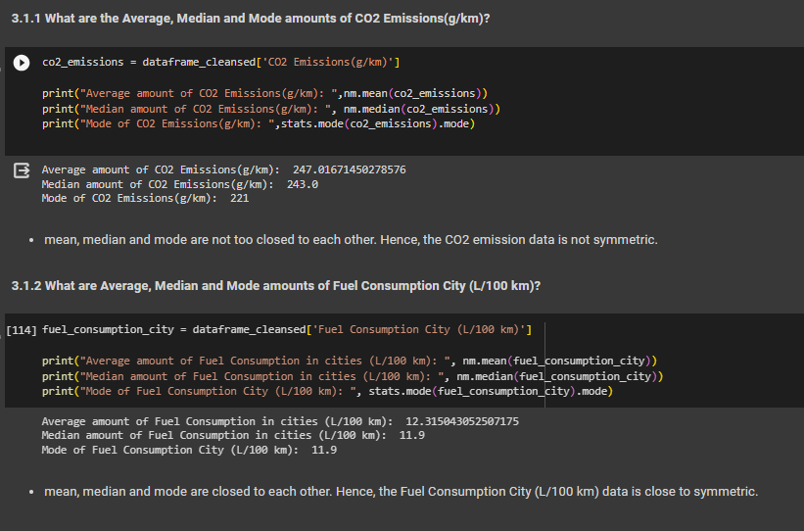
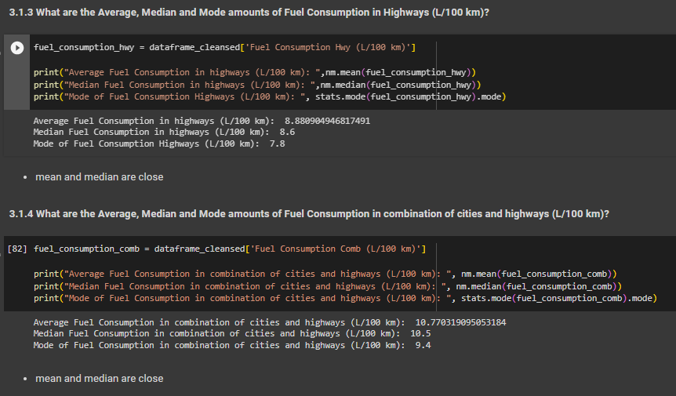
3. Basic STATISTICS
3.1 Central Tendency
Notes:
Examples of nominal attributes include:
Gender: Categories might include "Male" and "Female."
Colors: Categories might include "Red," "Blue," and "Green."
Marital Status: Categories might include "Single," "Married," and "Divorced."
Examples of binary attributes include:
Gender: Represented as "Male" or "Female."
Smoking Status: Represented as "Smoker" or "Non-smoker."
Employment Status: Represented as "Employed" or "Unemployed."
Education Level: Categories might include "High School," "Associate's Degree," "Bachelor's Degree," "Master's Degree," and "Doctorate." There is a clear order from less education to more education, but the intervals between these levels may vary.
Socioeconomic Status: Categories might include "Low Income," "Middle Income," and "High Income." There is an order based on income level, but the exact difference between "Low Income" and "Middle Income" is not precisely defined.
Customer Satisfaction Rating: Categories might include "Very Dissatisfied," "Dissatisfied," "Neutral," "Satisfied," and "Very Satisfied." There is an ordinal ranking indicating the level of satisfaction, but the difference in satisfaction between adjacent categories may not be uniform.

Slide 13
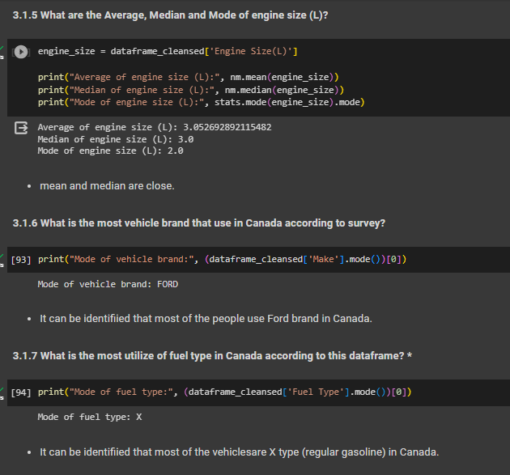
3.1 Central Tendency cont…
Notes:
Examples of nominal attributes include:
Gender: Categories might include "Male" and "Female."
Colors: Categories might include "Red," "Blue," and "Green."
Marital Status: Categories might include "Single," "Married," and "Divorced."
Examples of binary attributes include:
Gender: Represented as "Male" or "Female."
Smoking Status: Represented as "Smoker" or "Non-smoker."
Employment Status: Represented as "Employed" or "Unemployed."
Education Level: Categories might include "High School," "Associate's Degree," "Bachelor's Degree," "Master's Degree," and "Doctorate." There is a clear order from less education to more education, but the intervals between these levels may vary.
Socioeconomic Status: Categories might include "Low Income," "Middle Income," and "High Income." There is an order based on income level, but the exact difference between "Low Income" and "Middle Income" is not precisely defined.
Customer Satisfaction Rating: Categories might include "Very Dissatisfied," "Dissatisfied," "Neutral," "Satisfied," and "Very Satisfied." There is an ordinal ranking indicating the level of satisfaction, but the difference in satisfaction between adjacent categories may not be uniform.

Slide 14
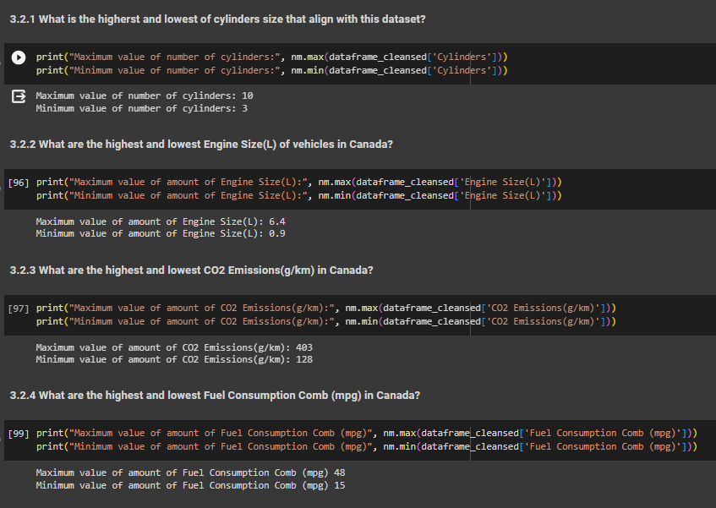
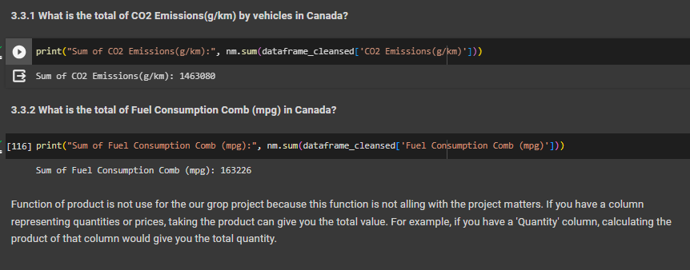
3.2 Min Max
3.3 Sum and Product
Notes:
Examples of nominal attributes include:
Gender: Categories might include "Male" and "Female."
Colors: Categories might include "Red," "Blue," and "Green."
Marital Status: Categories might include "Single," "Married," and "Divorced."
Examples of binary attributes include:
Gender: Represented as "Male" or "Female."
Smoking Status: Represented as "Smoker" or "Non-smoker."
Employment Status: Represented as "Employed" or "Unemployed."
Education Level: Categories might include "High School," "Associate's Degree," "Bachelor's Degree," "Master's Degree," and "Doctorate." There is a clear order from less education to more education, but the intervals between these levels may vary.
Socioeconomic Status: Categories might include "Low Income," "Middle Income," and "High Income." There is an order based on income level, but the exact difference between "Low Income" and "Middle Income" is not precisely defined.
Customer Satisfaction Rating: Categories might include "Very Dissatisfied," "Dissatisfied," "Neutral," "Satisfied," and "Very Satisfied." There is an ordinal ranking indicating the level of satisfaction, but the difference in satisfaction between adjacent categories may not be uniform.

Slide 15
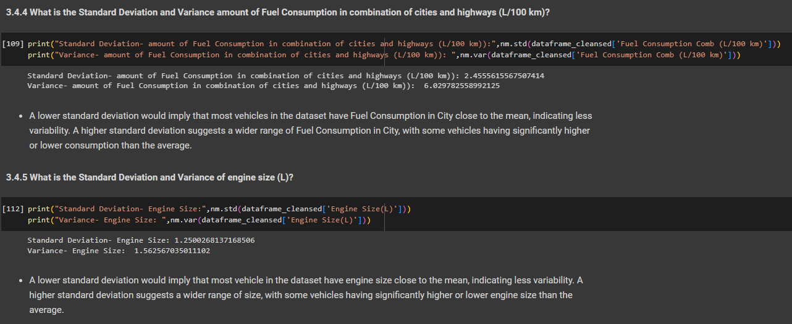
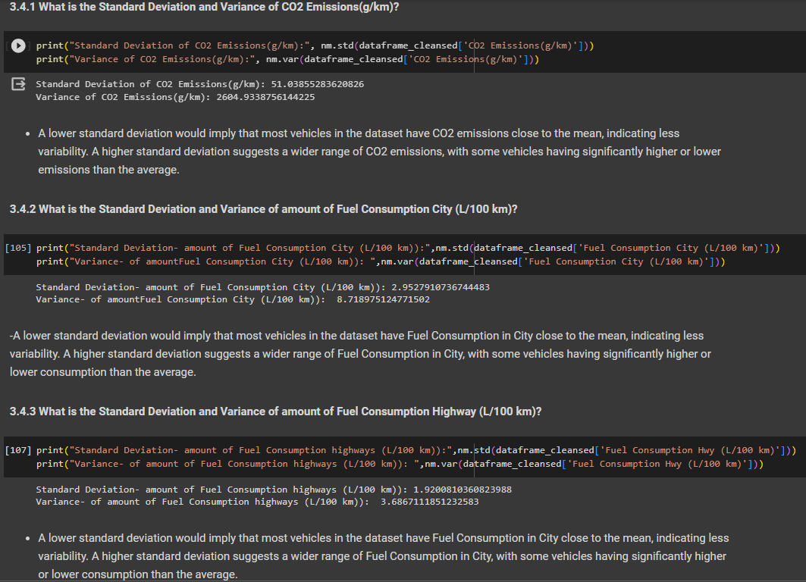
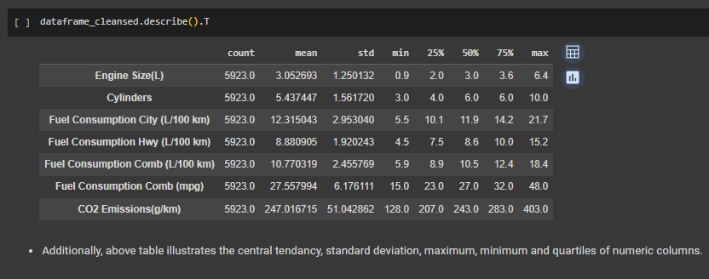
3.4 STD and Variance
Notes:
Examples of nominal attributes include:
Gender: Categories might include "Male" and "Female."
Colors: Categories might include "Red," "Blue," and "Green."
Marital Status: Categories might include "Single," "Married," and "Divorced."
Examples of binary attributes include:
Gender: Represented as "Male" or "Female."
Smoking Status: Represented as "Smoker" or "Non-smoker."
Employment Status: Represented as "Employed" or "Unemployed."
Education Level: Categories might include "High School," "Associate's Degree," "Bachelor's Degree," "Master's Degree," and "Doctorate." There is a clear order from less education to more education, but the intervals between these levels may vary.
Socioeconomic Status: Categories might include "Low Income," "Middle Income," and "High Income." There is an order based on income level, but the exact difference between "Low Income" and "Middle Income" is not precisely defined.
Customer Satisfaction Rating: Categories might include "Very Dissatisfied," "Dissatisfied," "Neutral," "Satisfied," and "Very Satisfied." There is an ordinal ranking indicating the level of satisfaction, but the difference in satisfaction between adjacent categories may not be uniform.

Slide 16
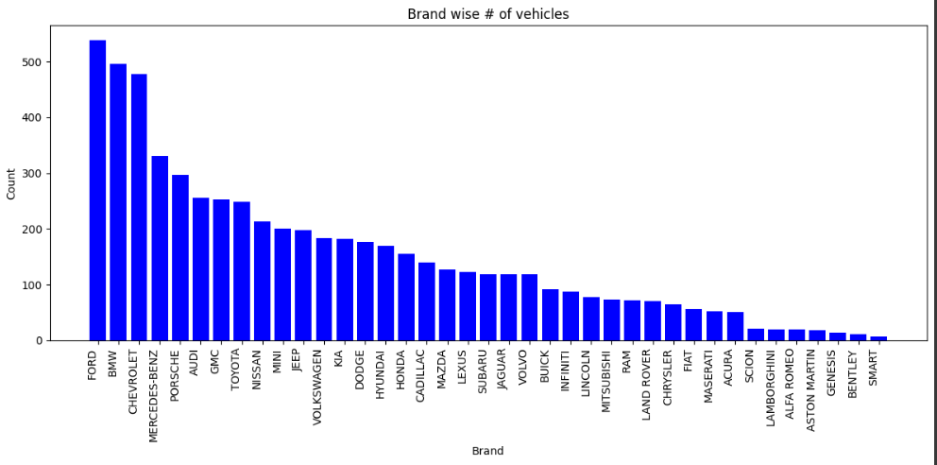
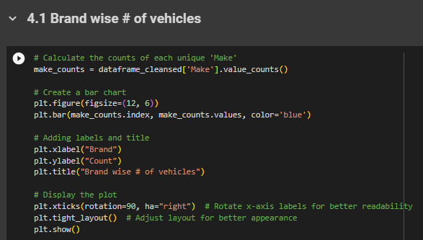
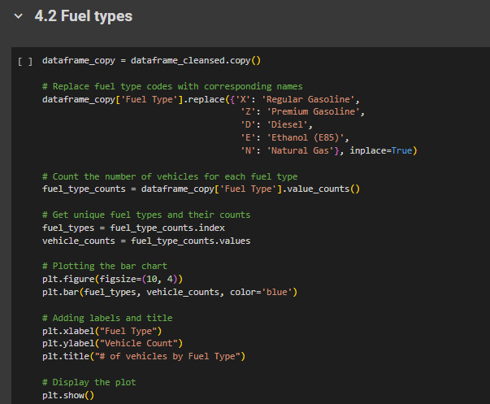
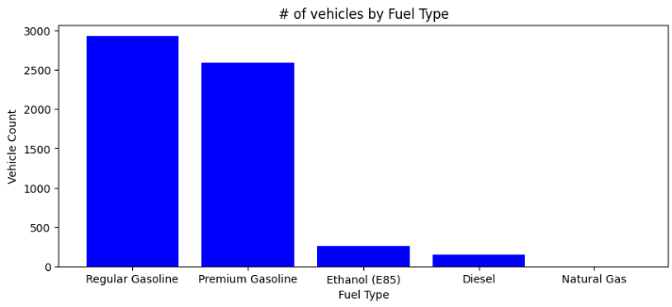
4. Visualization
Most of the vehicles are Ford (538)
Least used vehicle brand is SMART(7).
Most of the vehicles (2928) use Regular Gasoline
Least amount of vehicles (1) use Natural gas

Slide 17
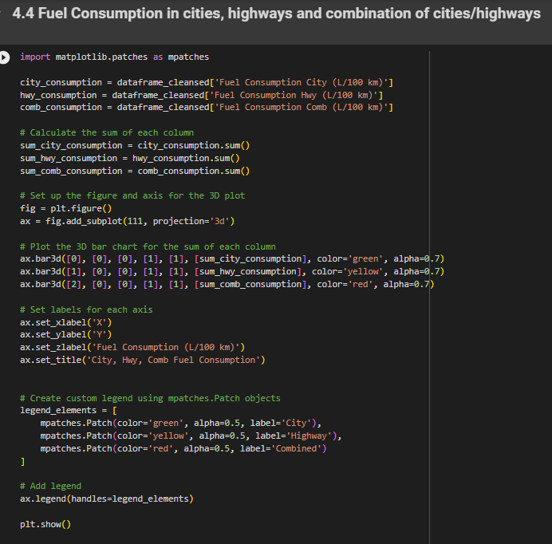
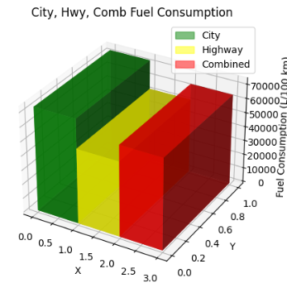
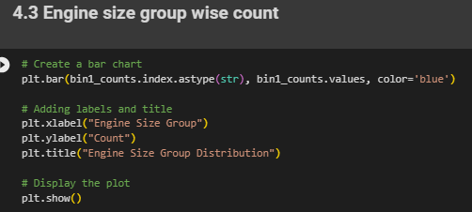
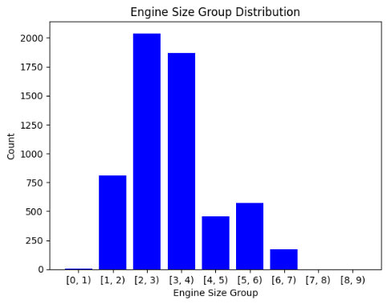
4. Visualization
Amount of fuel consumption in cities is higher than in highways.
Most of the vehicles have engine sizes between 2-3 (2039 vehicles)
Least of the vehicles have 0-1 (3 vehicles)

Slide 18
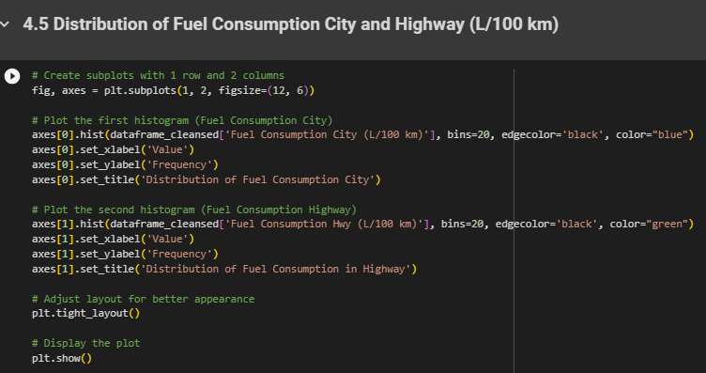
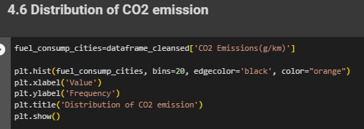
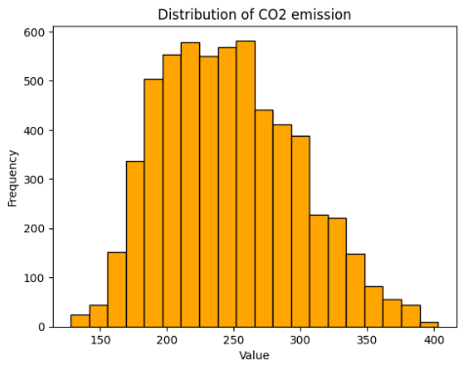
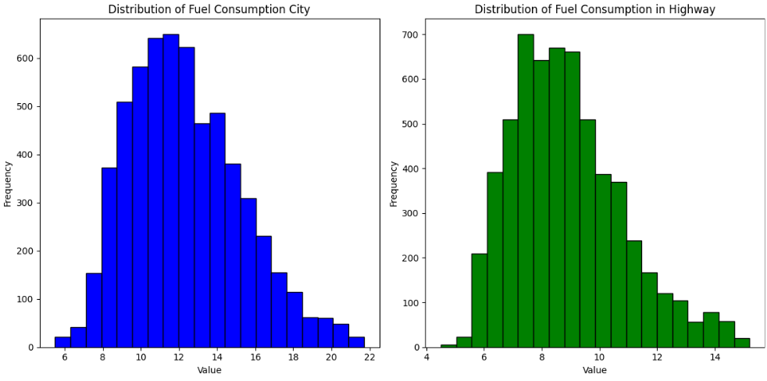
4. Visualization
Based on the above two graphs, it can be identified that both histograms are slightly right skewed. i.e. majority of the vehicles in Canada consume low level of fuel.
According to the above figure, it can be identified that distribution of CO2 emission in Canada is slightly right skewed. Therefore, the amount of CO2 emission by vehicles is low.

Slide 19
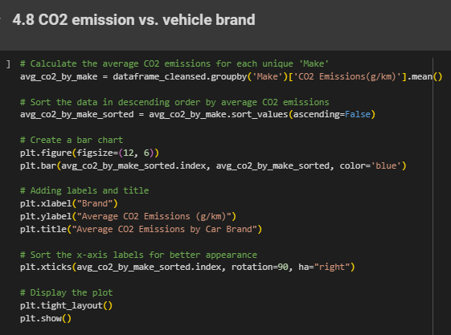
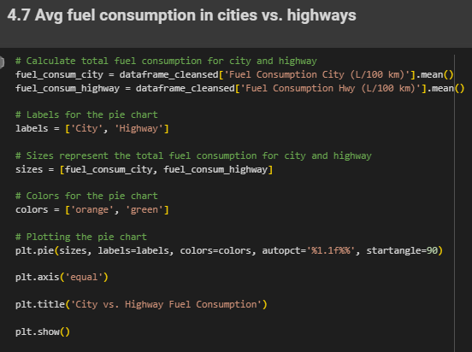
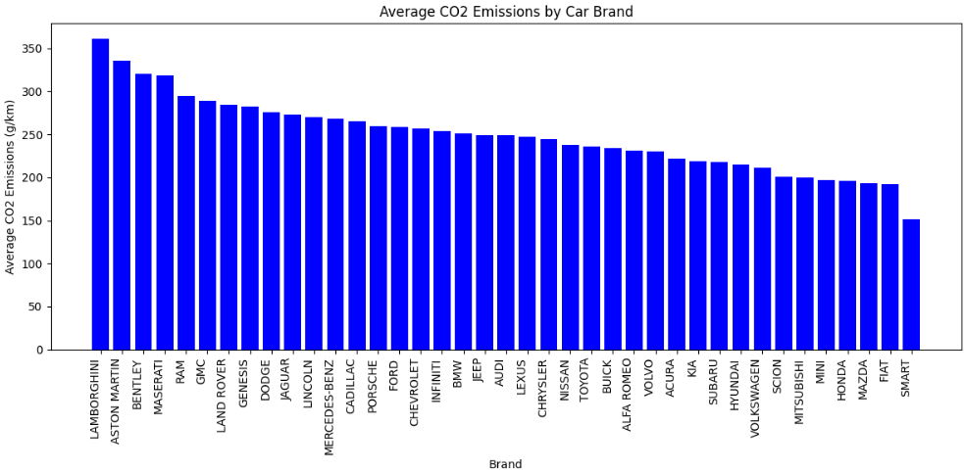
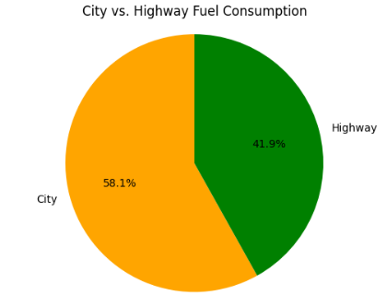
4. Visualization
LAMBORGHINI vehicle brand has the highest average of CO2 emission (360.7) while SMART vehicle brand has the least (151.4).
Fuel consumption of vehicles in cities (58.1%) is higher than in highways(41.9%).

Slide 20
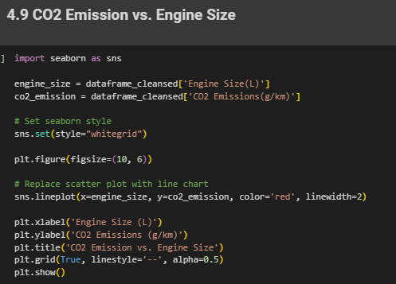
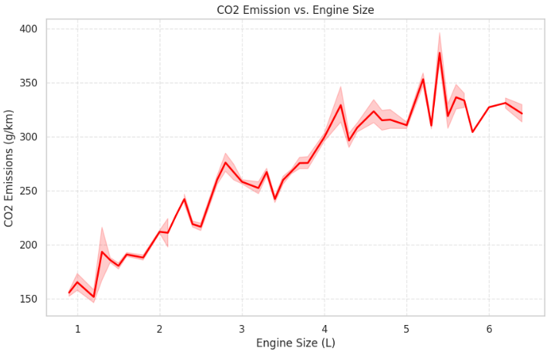
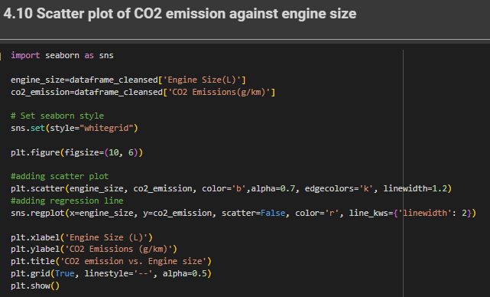
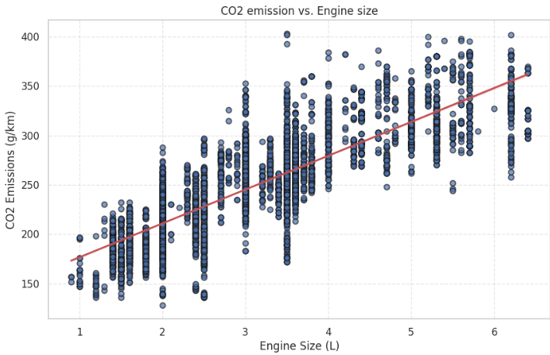
4. Visualization
Line chart illustrates that amount of Co2 emission goes high when the size of engine increases.
There is a positive relationship between engine size and CO2 emission
This may further conclude that amount of Co2 emission goes higher when the size of engine increases.

Slide 21
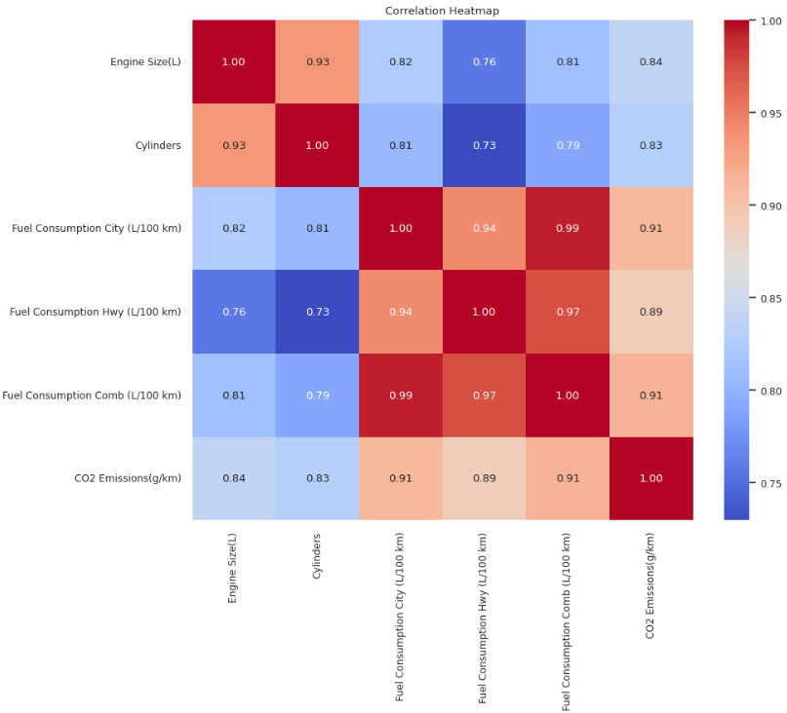
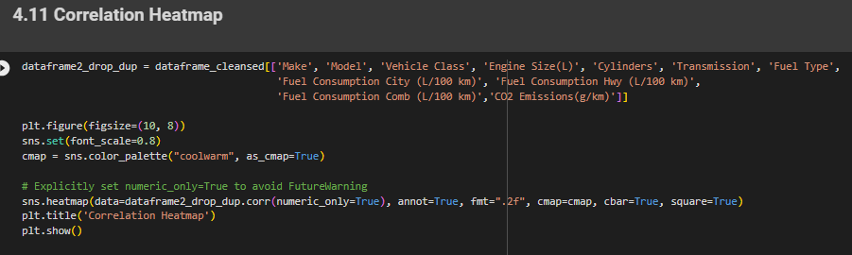
4. Visualization
Based on the above heat correlation graph, it can be conclude that there is strong positive correlation between following parameters.
engine size and CO2 emission
engine size and fuel consumption in cities
engine size and fuel consumption in highways
No. of cylinders and CO2 emission
No. of cylinders and fuel consumption in cities
No. of cylinders and fuel consumption in highways
fuel consumption and CO2 emission

Slide 22
5. Conclusion
Most of the vehicles are Ford (538) while the least used vehicle brand is SMART(7).
It can be concluded that most of the vehicles (2928) use Regular Gasoline while least amount of vehicles (1) use Natural gas.
Amount of fuel consumption in cities is higher than in highways.
Fuel consumption of vehicles in cities (58.1%) is higher than in highways(41.9%).
LAMBORGHINI vehicle brand has the highest average of CO2 emission (360.7) while SMART vehicle brand has the least (151.4).
There is strong positive correlation between following parameters.
engine size and CO2 emission
engine size and fuel consumption in cities
engine size and fuel consumption in highways
No. of cylinders and CO2 emission
No. of cylinders and fuel consumption in cities
No. of cylinders and fuel consumption in highways
fuel consumption and CO2 emission

Slide 23
6. References
Akyol, G. (2023, 11 1). Getting to Know Your Data | Data Mining #2. Retrieved from Medium: https://medium.com/@gokcenazakyol/getting-to-know-your-data-data-mining-3-fb3be00941ff#:~:text=Data%20Objects%20and%20Attribute%20Types&text=Attribute%20(or%20dimensions%2C%20features%2C,%2C%20ordinal%2C%20binary%2C%20numeric.
Podder, D. (2020). kaggle. Retrieved from CO2 Emission by Vehicles: https://www.kaggle.com/datasets/debajyotipodder/co2-emission-by-vehicles

Slide 24

Questions

Slide 25
Thank You

